Slide 1
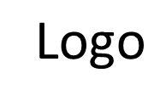
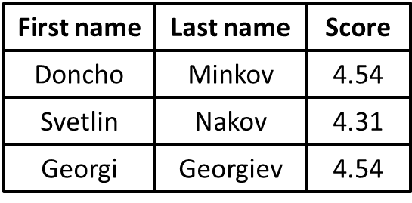
Welcome to Our Web Site
Nav item 1
Nav item 1
Nav item 1
Nav item 1

Slide 2
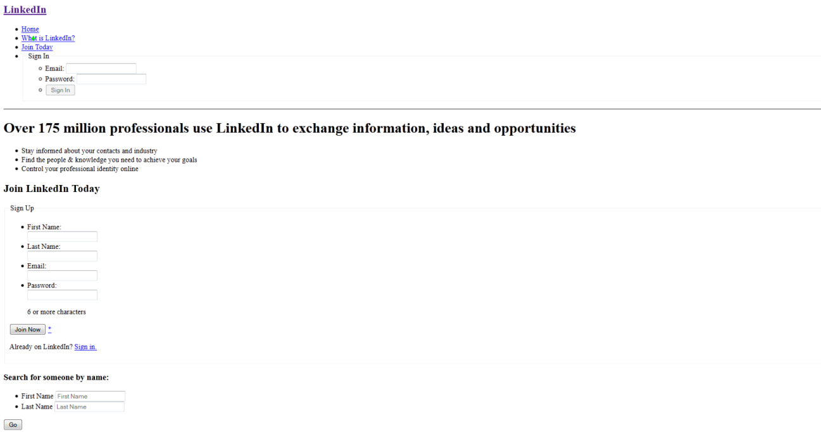

Slide 3
3. Refactoring refactoring-homework.html using semantic HTML

